Slide 1

AWS Cloud Formation

Slide 2
What is Infrastructure as a Code (IaaC) ?
A fundamental principle of DevOps is to treat infrastructure the same way developers treat code.
Practicing infrastructure as code means applying the same rigor of application code development to infrastructure provisioning.
All configurations should be defined in a declarative way and stored in a source control system such as AWS CodeCommit, the same as application code.
Infrastructure provisioning, orchestration, and deployment should also support the use of the infrastructure as code.

Slide 3
Why IaaC is required ?
Infrastructure was traditionally provisioned using a combination of scripts and manual processes.
Sometimes these scripts were stored in version control systems or documented step by step in text files or run-books.
Often the person writing the run books is not the same person executing these scripts or following through the run-books.
If these scripts or runbooks are not updated frequently, they can potentially become a show-stopper in deployments.
This results in the creation of new environments not always being repeatable, reliable, or consistent.

Slide 4
Benefits of IaaC
Benefits the DevOps team by allowing the operators to evolve in the development process from beginning and developers to gain a better understanding of supporting infrastructure
The Configuration files contains everything that makes up the operating environment like : compute, storage, network and application services
Cost reduction
Increase in speed of deployments
Reduce errors
Improve infrastructure consistency
Eliminate configuration drift

Slide 5
What is CloudForamtion ?
CloudFormation is a service that helps the user in provisioning and configuring the AWS resources via declarative templates to avoid spending more time on manage resources, and focus only on the application running in AWS.
Resources are written in text files using JSON or YAML format.
The templates require a specific syntax and structure that depends on the types of resources being created and managed.
You author your resources in JSON or YAML with any code editor such as AWS Cloud9, check it into a version control system, and then CloudFormation builds the specified services in safe, repeatable manner.

Slide 6
Features of CloudFormation
It treats all the resources in a template as a single stack
It is used to process the process infrastructure templates to provide an infrastructure
When deploying environment with Multiple resources like ELB, S3, databases and more, this is the best option
Here, there is no need to mention the order of services, it automatically sets the order
To delete an environment just click on “delete stack” and CloudFormation deletes all the resources associated with the stack.

Slide 7
Working with CloudFormation
A CloudFormation template is deployed into the AWS environment as a stack.
You can manage stacks through the AWS Management Console, AWS Command Line Interface, or AWS CloudFormation APIs.
If you need to make changes to the running resources in a stack you update the stack.
Before making changes to your resources, you can generate a change set, which is a summary of your proposed changes, this would help with understanding as how stack will be impacted

Slide 8
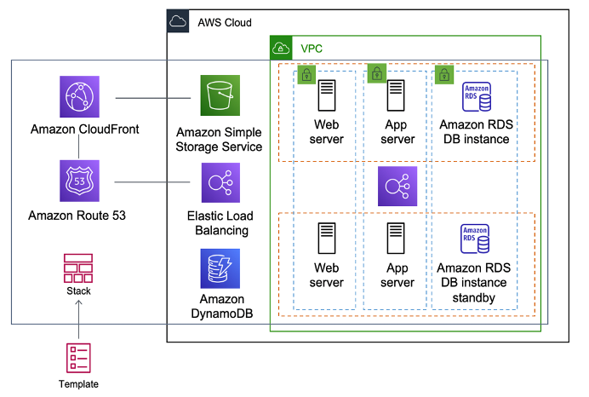
CloudFormation Template & Stack
Source: AWS

